Slide 1


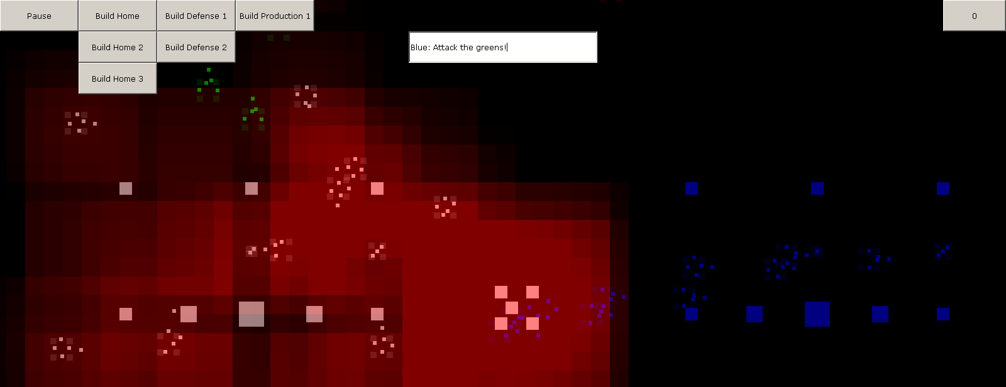
Tactical Level Game AI with Natural Language Input
Student: Piers Williams Supervisor: Dr. Massimo Poesio
Introduction
This is a project that is all about bringing human and computer Artificial Intelligence (AI) interaction close within a Real Time Strategy (RTS) computer game.
What is an RTS?
An RTS game is one of those games with top down graphics where you command your units and buildings in a more global scale than more common First Person Shooters (FPS). To the right is an example of a good RTS called Supreme Commander. A lot of the simple mechanics of my game are based on those observed in Supreme Commander.
Why do this?
I’m doing this after years of frustration with the single minded and un-cooperative nature of many RTS AI systems in games. Many tout having teams and alliances and trading however they are little more than token gestures that only work human-human. I wanted to create an Artificial Intelligence that could use those features through English input.
Natural Language
The interaction is achieved using a Natural Language Pipeline that is designed to translate English instructions into an internal language, that I called Strategic Planning Language (SPL), that the AI can understand. The AI uses this language internally, allowing the human players to directly inject instructions into the AI’s Queue.
The pipeline begins with English input from the User. This is then Part Of Speech (POS) tagged by the Stanford Tagger. Next a series of pattern matching extracts information from the text and converts them to SPL for the AI.
Co-operation
The co-operation is achieved by means of instructions that can be issued to the AI. These instructions are for defending, attacking, trading or querying.
Attacking – Attacking a target, area or base for you
Defending – Defending an existing base, defending an area by occupying it
Trading – Trading units with the AI
Querying – Asking the AI for information about the world or itself
English Instructions
POS Tagged Text
SPL
The Natural Language Process
Possible Refinements
The AI could use some clever features to check if it is happy with the orders you have given it. These could include trust systems that allow you to build up leverage with the AI. The AI could also propose slight alterations that go through less defended territory or use more or less units than originally planned. These could then be approved by the Human before interaction. Triggers could be added that allow timed actions between human and AI players.
The game (Cropped) showing two bases and the input for the NLP

